Slide 1


ENGR 1111 Intro to Engineering: Civil Engineering Fall 2022 Part 2: Engineering

Slide 2
Part 2: Engineering
OSU ENGR 1111 Catalog Description:
An introduction to the study and practice of engineering. Skills for students in CEAT; expected engineering student behavior; tools needed by CEAT students; and the role of engineers in society. An introduction to engineering ethics; safety issues; and the relationship of engineering to social, global and contemporary issues. Student enrichment opportunities in the CEAT.
Lecture, exercises, reading and homework to acquire knowledge of engineering disciplines, educational opportunities, and careers

Slide 3
Part 2: Engineering
ABET Definition of Engineering:
The profession in which a knowledge of the mathematical and natural sciences gained by study, experience, and practices is applied with judgement to develop ways to utilize, economically, the materials and forces of nature for the benefit of [humans].
Goal: SOLVE PROBLEMS!
Notes:
Design, analysis, testing, project management, technical sales, operations management

Slide 4
Part 2: Engineering
Food
Industrial
Materials
Mechanical
Naval
Nuclear
Ocean
Petroleum
Systems
Aeronautical
Agricultural
Architectural
Biomedical
Chemical
Civil
Computer
Electrical
Environmental

Slide 5
Part 2: Engineering
Engineering at OSU:
Biosystems and Agricultural (or Biological)
Concerned with systems and devices that have a significant biological component
Chemical
Apply principles of chemistry to the design of manufacturing and production systems
Civil and Environmental
Design and construct the world’s infrastructure
Electrical and Computer
Design and build devices that apply and use electricity
Industrial Engineering and Management
Design and implement complex production systems
Mechanical and Aerospace
Design and build devices that involve mechanical motion and flight

Slide 6
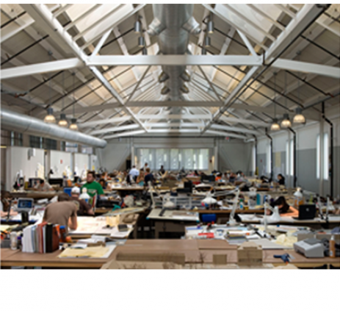
Part 2: Engineering
Architecture at OSU:
Architecture
design space and create total interior and exterior environments according the to customer’s needs
Architectural Engineering
design of safe and economical structural systems used in buildings

Slide 7
Part 2: Engineering
Engineering Technology at OSU:
Construction Engineering Technology
Manage the process of building of the world’s infrastructure – both vertical and horizontal
Electrical Engineering Technology
Design and application of devices not only in the electronics industry itself, but also in many other areas in modern industry that depend upon electronics for control, communications or computation.
Fire Protection and Safety Engineering Technology
Focus on loss control in fire protection, industrial hygiene and safety, and fire service
Mechanical Engineering Technology
Specializes in design and application - MET includes the broad areas of mechanical design, mechanical power and manufacturing

Slide 8
Part 2: Engineering
Accreditation
ABET
Engineering
Technology
https://www.abet.org/about-abet/
NAAB
Architecture
NCEES – licensing board
https://ncees.org/engineering/

Slide 9

Part 2: Engineering
Scientists and Engineers:
Scientist
Seeks to expand knowledge
Draws general conclusions
Produces knowledge
Engineer
Seeks to apply knowledge
Translates general knowledge to specific solutions
Produces devices to meet human needs and solve problems

Slide 10

Engineers…
Part 2: Engineering
Have been shaping civilization for centuries.
Were first employed to devise military machines.
Name three engineered inventions, that are still being used today, that changed the course of mankind.

Slide 11

Engineers…
Part 2: Engineering
Use the advancement in technology to improve on existing ideas.
Expanded into different fields such as civil structural, automotive and aeronautic.
Shifted their focus from military to bettering life for everyone.

Slide 12
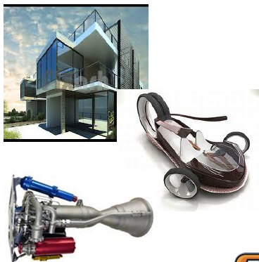
Engineers…
Part 2: Engineering
Have the newest technology at their disposal.
Create new materials to meet the needs of their design.
Develop new methods of construction and production

Slide 13


Engineers require/develop…
Part 2: Engineering
Skills
Knowledge
Experience
Intuition
Notes:
Theoretical and practical knowledge / skills
l Calculus, Physics, Statics, Thermo . . .
l Heat exchanger design, manufacturing
tolerances for microchip fabrication . . .
l Regulations, corporate design standards . . .
¢ Organization, communication, documentation
l English, Speech, Sociology, Philosophy . . .
¢ Broad knowledge in “non-major” areas
l Economics, related engineering disciplines . . .
¢ Knowledge, experience, intuition
Knowledge
¢ The body of facts used to form
strategies, analyze systems, and
predict results
l Formal education
l On-the-job training
l Life-long learning
Experience
¢ The body of methods, procedures, techniques,
and rules of thumb used to solve problems
l Mentoring (passing on the “secrets” and tricks of
the trade) – However, such tricks do not negate
the requirement to check and verify calculations!
l Completion of successful projects
l Failure
¢ Sometime the best design isn’t the “right” one
l Engineers work within a system of constraints
that include cost, manufacturability,
maintenance, marketing, etc.
Intuition
¢ A basic instinct about what will or will not
work as a problem solution
l “Good engineering judgment” – based on a
strong understanding of the systems and
effects, and capability to “know” if calculated
results do not seem right
l Might make some back of the envelope
calculations to check a computer simulation
l Can help to narrow down the design process
when too many potential solutions exist
l Grounded in experience and knowledge
• Practice, practice, practice

Slide 14
ENGR 1111 Intro to Engineering: Civil Engineering Fall 2022 Part 2: Engineering

